Slide 1

Vision control
[1]

Slide 2



Project Team
FH-Prof. Dipl.-Ing. Dr. Wolfgang Werth
Heinz-Peter Liechtenecker, BSc MSc
Gregor Fritz
Laurenz Hundgeburth

Slide 3
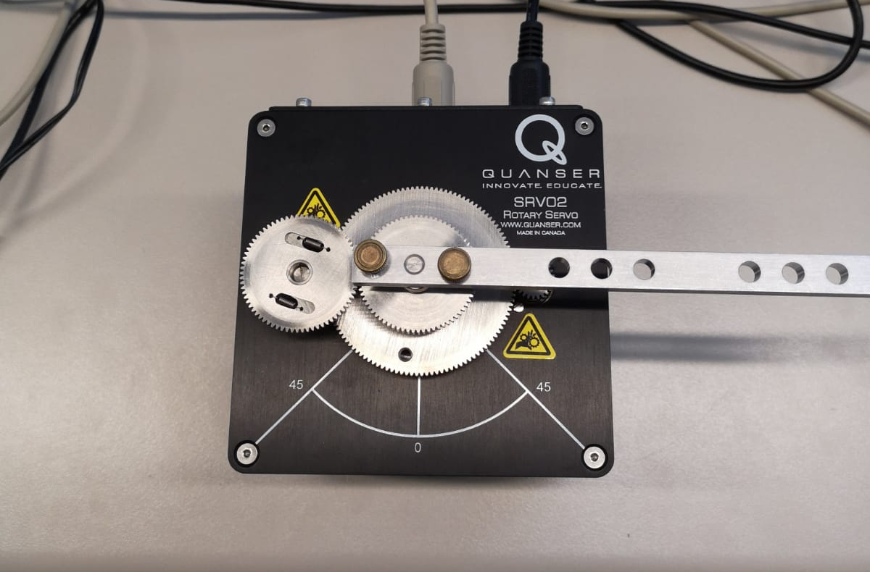
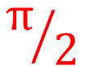
Goal
$$π/2$$
θ
0
Notes:
Goal: predict motor shaft angle out of an image
May seem trivial because humans are exceptionally good at extracting abstract information,
But very diffucult to programm with traditional methods.
The idea behind our project is to explore a new mothod more suited for such tasks: Machine learning.

Slide 4
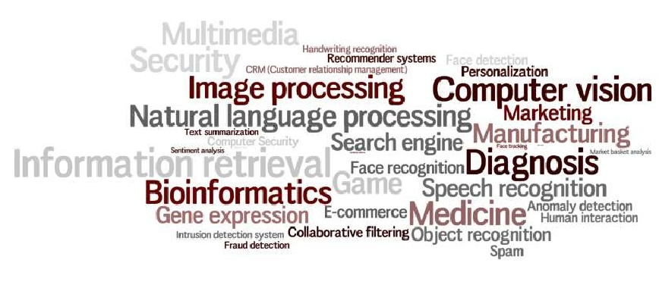
Machine Learning Definition / Examples
Machine learning is an application that provides systems the ability to automatically learn and improve from experience without being explicitly programmed. [1]
[2]

Slide 5
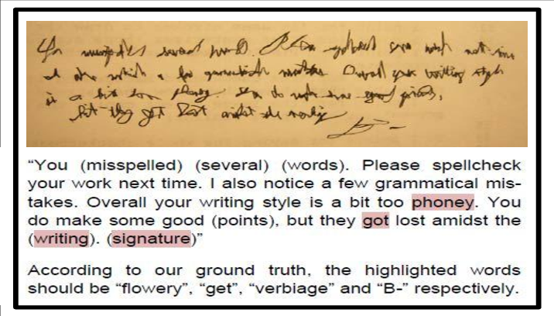
Machine Learning Motivation
[3]
Automate labour-intensive tasks which require intelligence
Abillity to generalize concepts leads to robustness against changing conditions
Notes:
Develope systems that con automatically adapt and costumise themselfs
Discover new knowledge from large data sets
Automate tasks which require some intelligence
-> good against noise and able to generalise to new examples

Slide 6
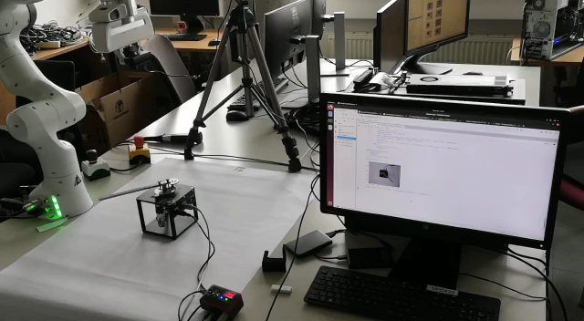
Final Setup

Slide 7
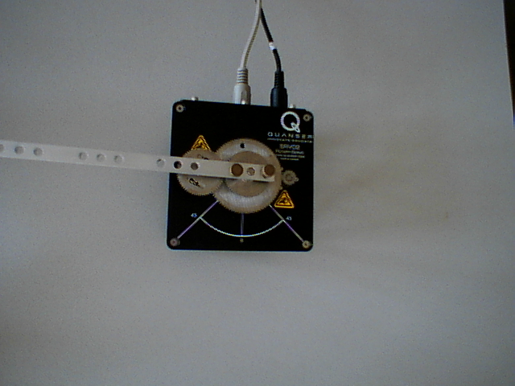
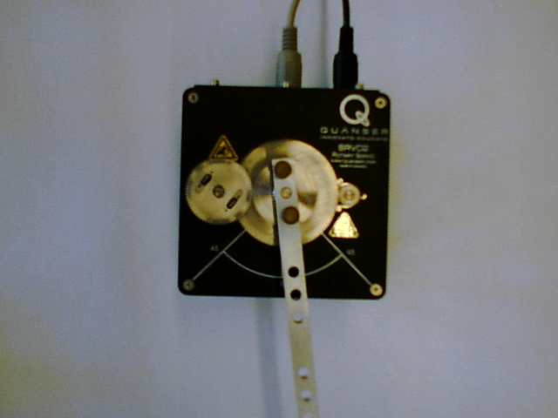
Supervised Learning
$${\text{θ}}_{1}$$
Input Images
Image Labels
-
$${\text{θ}}_{2}$$
+
1
Training
̂
$${\text{θ}}_{1}$$
Predictions
̂
2
$${\text{θ}}_{2}$$
Neural Network

Slide 8
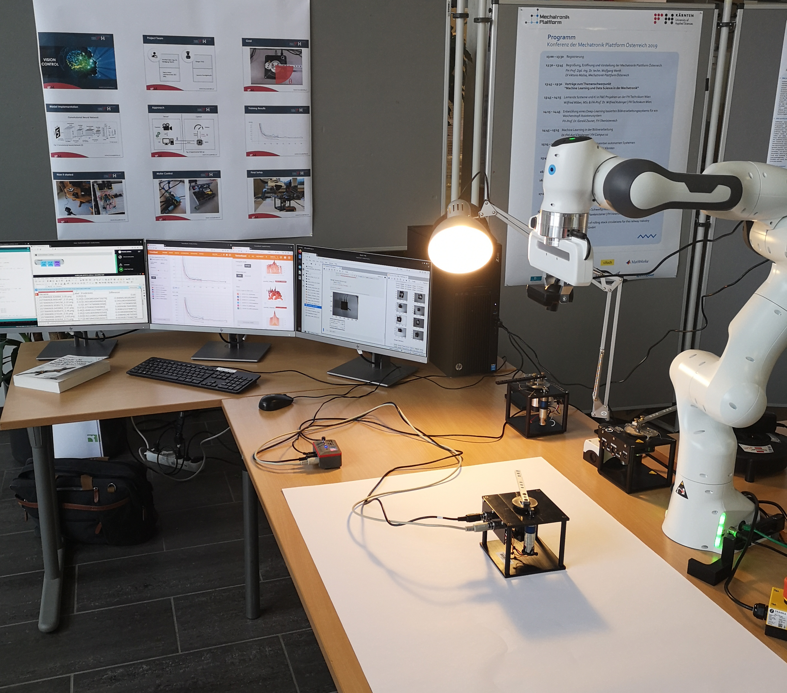





Approach
Camera
Motor
Motor Encoder
Motor Power
Images
θ
^
θ
PC
MCU
Training

Slide 9
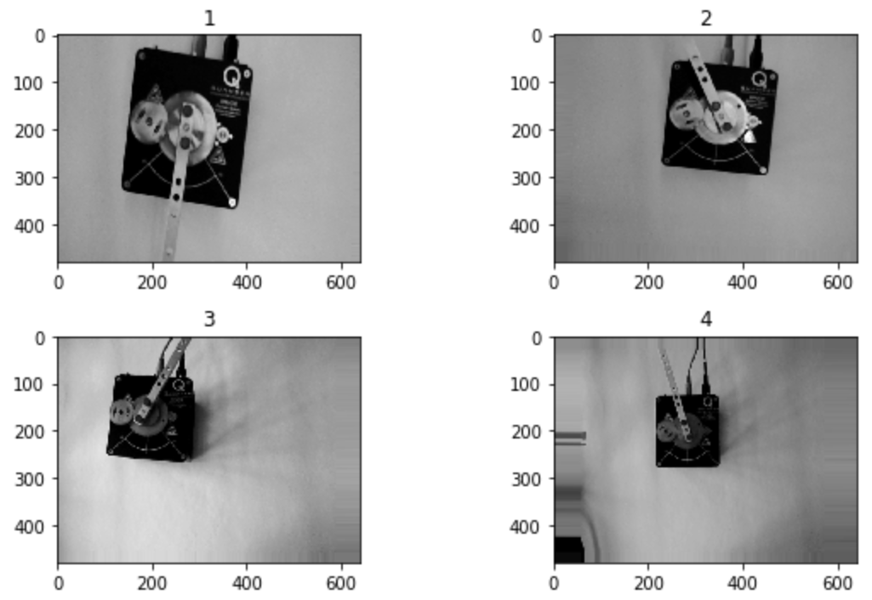
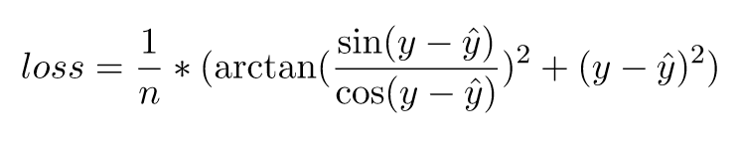
Training Details
Table 1: Data Sets
Data Set | Training | Validation | Testing
Size in Giga Byte | 28,3 | 3,84 | 3,84
Number of Images | 80.000 | 10.000 | 10.000
Data Augmentation
trained for 45 epochs
(3.600.000 training steps)
Convolutional Neural
Network Architecture
Custom Loss:

Slide 10
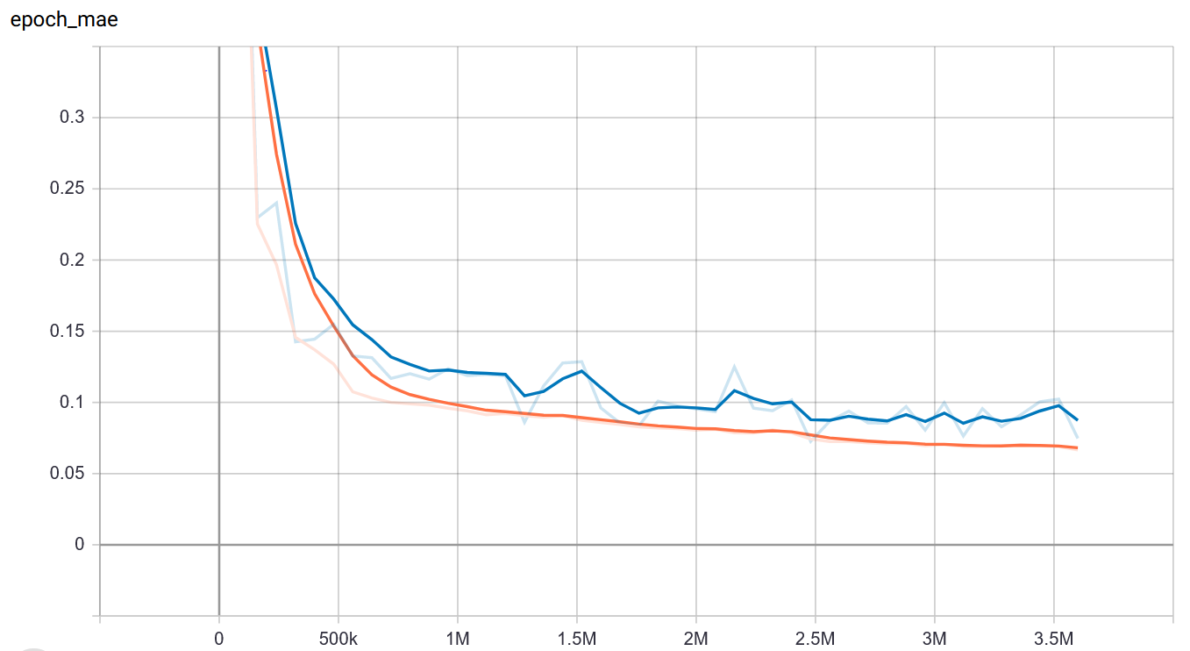
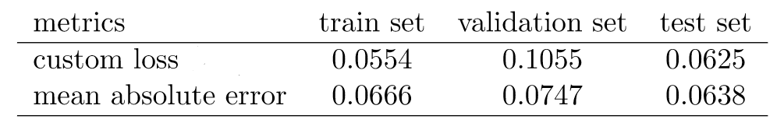
Training Results
Table 2: Model Evaluation

Slide 11
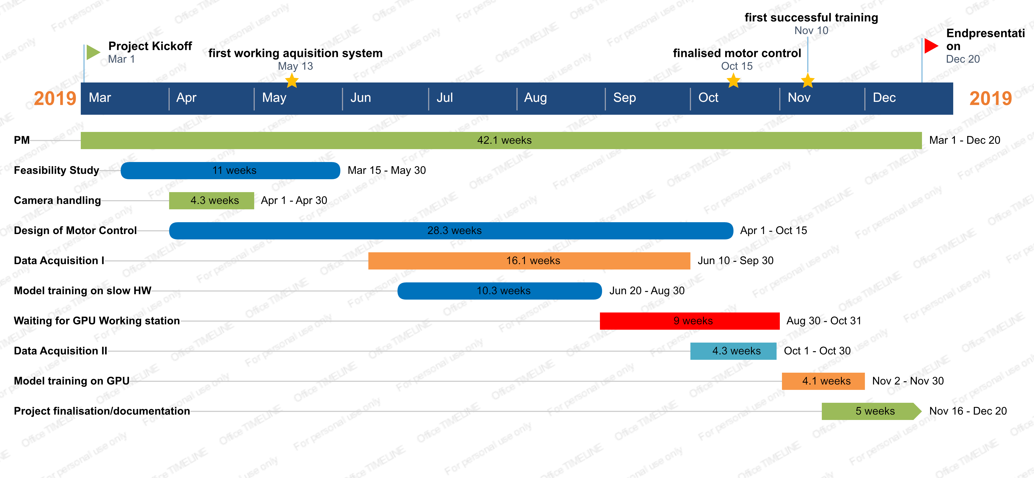
Timeline

Slide 12
Costs
Table 3: Project Costs
Items | Amount | Cost
Workhours | 800
USB-Camera | 1 | 15 €
Motor-Control | 1 | 20 €
Table 4: FH Resources
Items | Amount | Cost
GPU Workstations | 2 | 5.000 €
Quanser Servo Motor | 3 | 3.000 €
Franka Emika Panda | 1 | 15.000 €

Slide 13
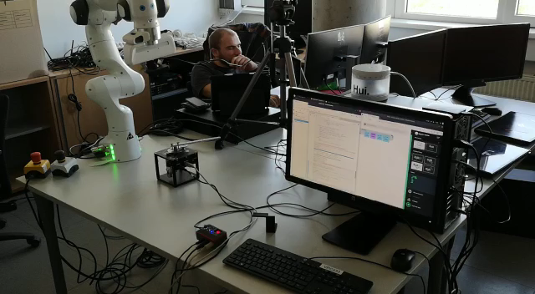
Live Demo Q & A

Slide 14
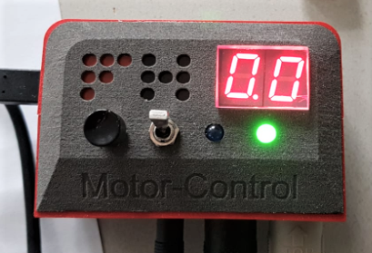
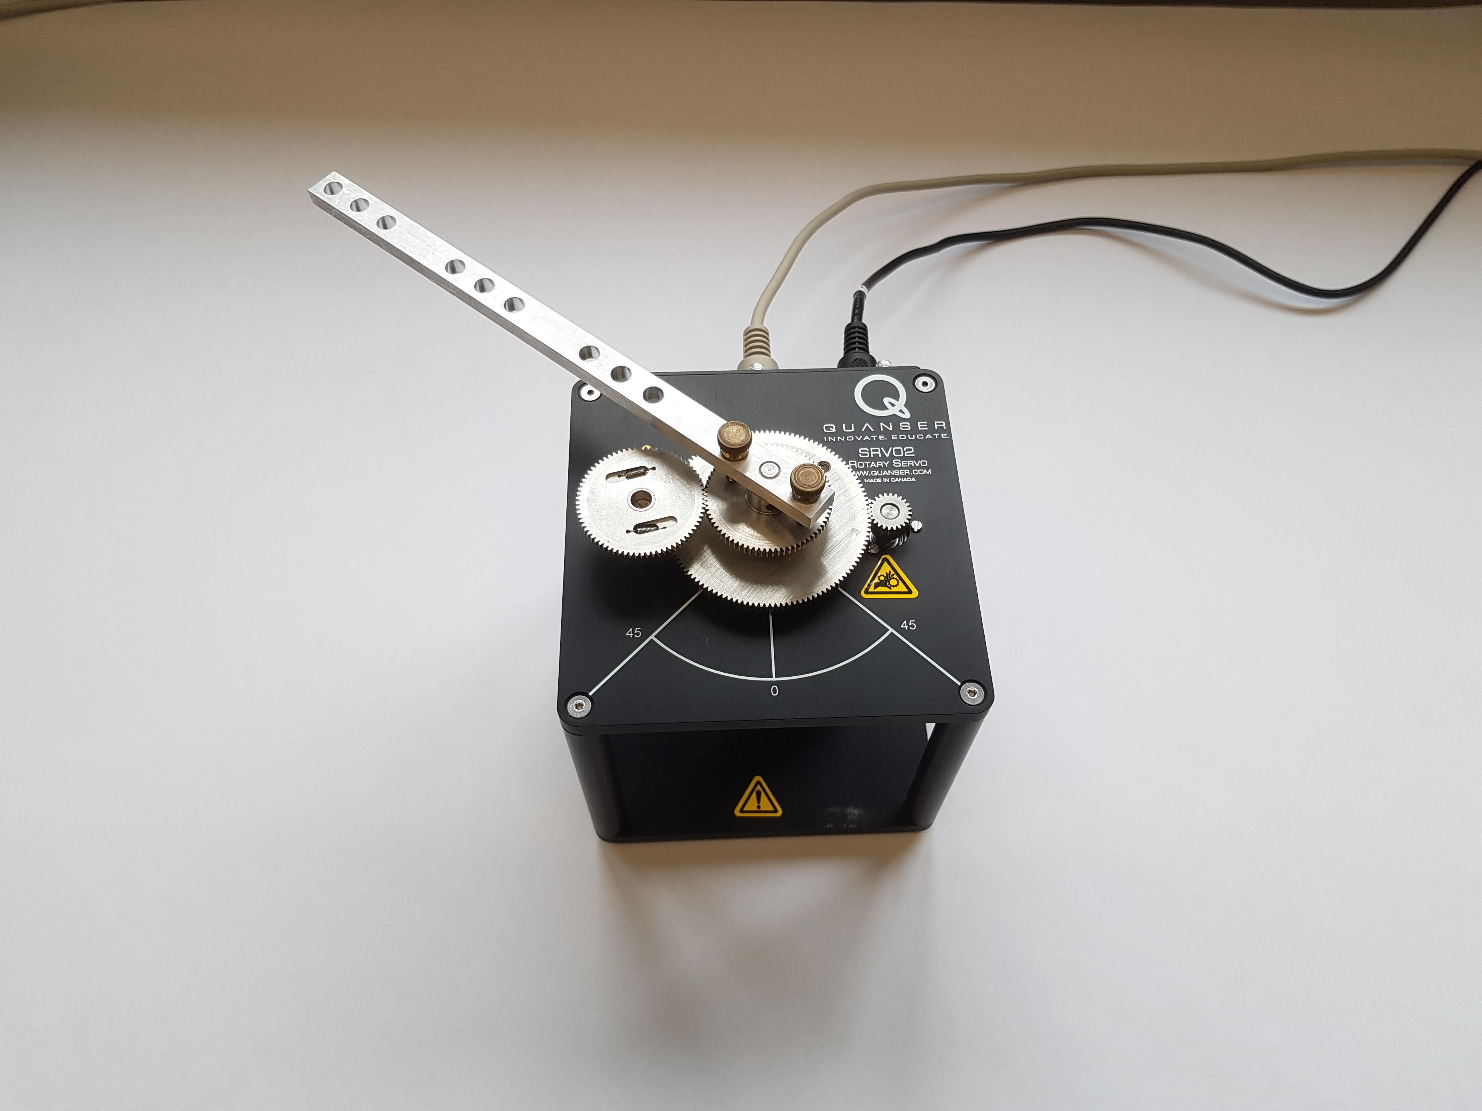
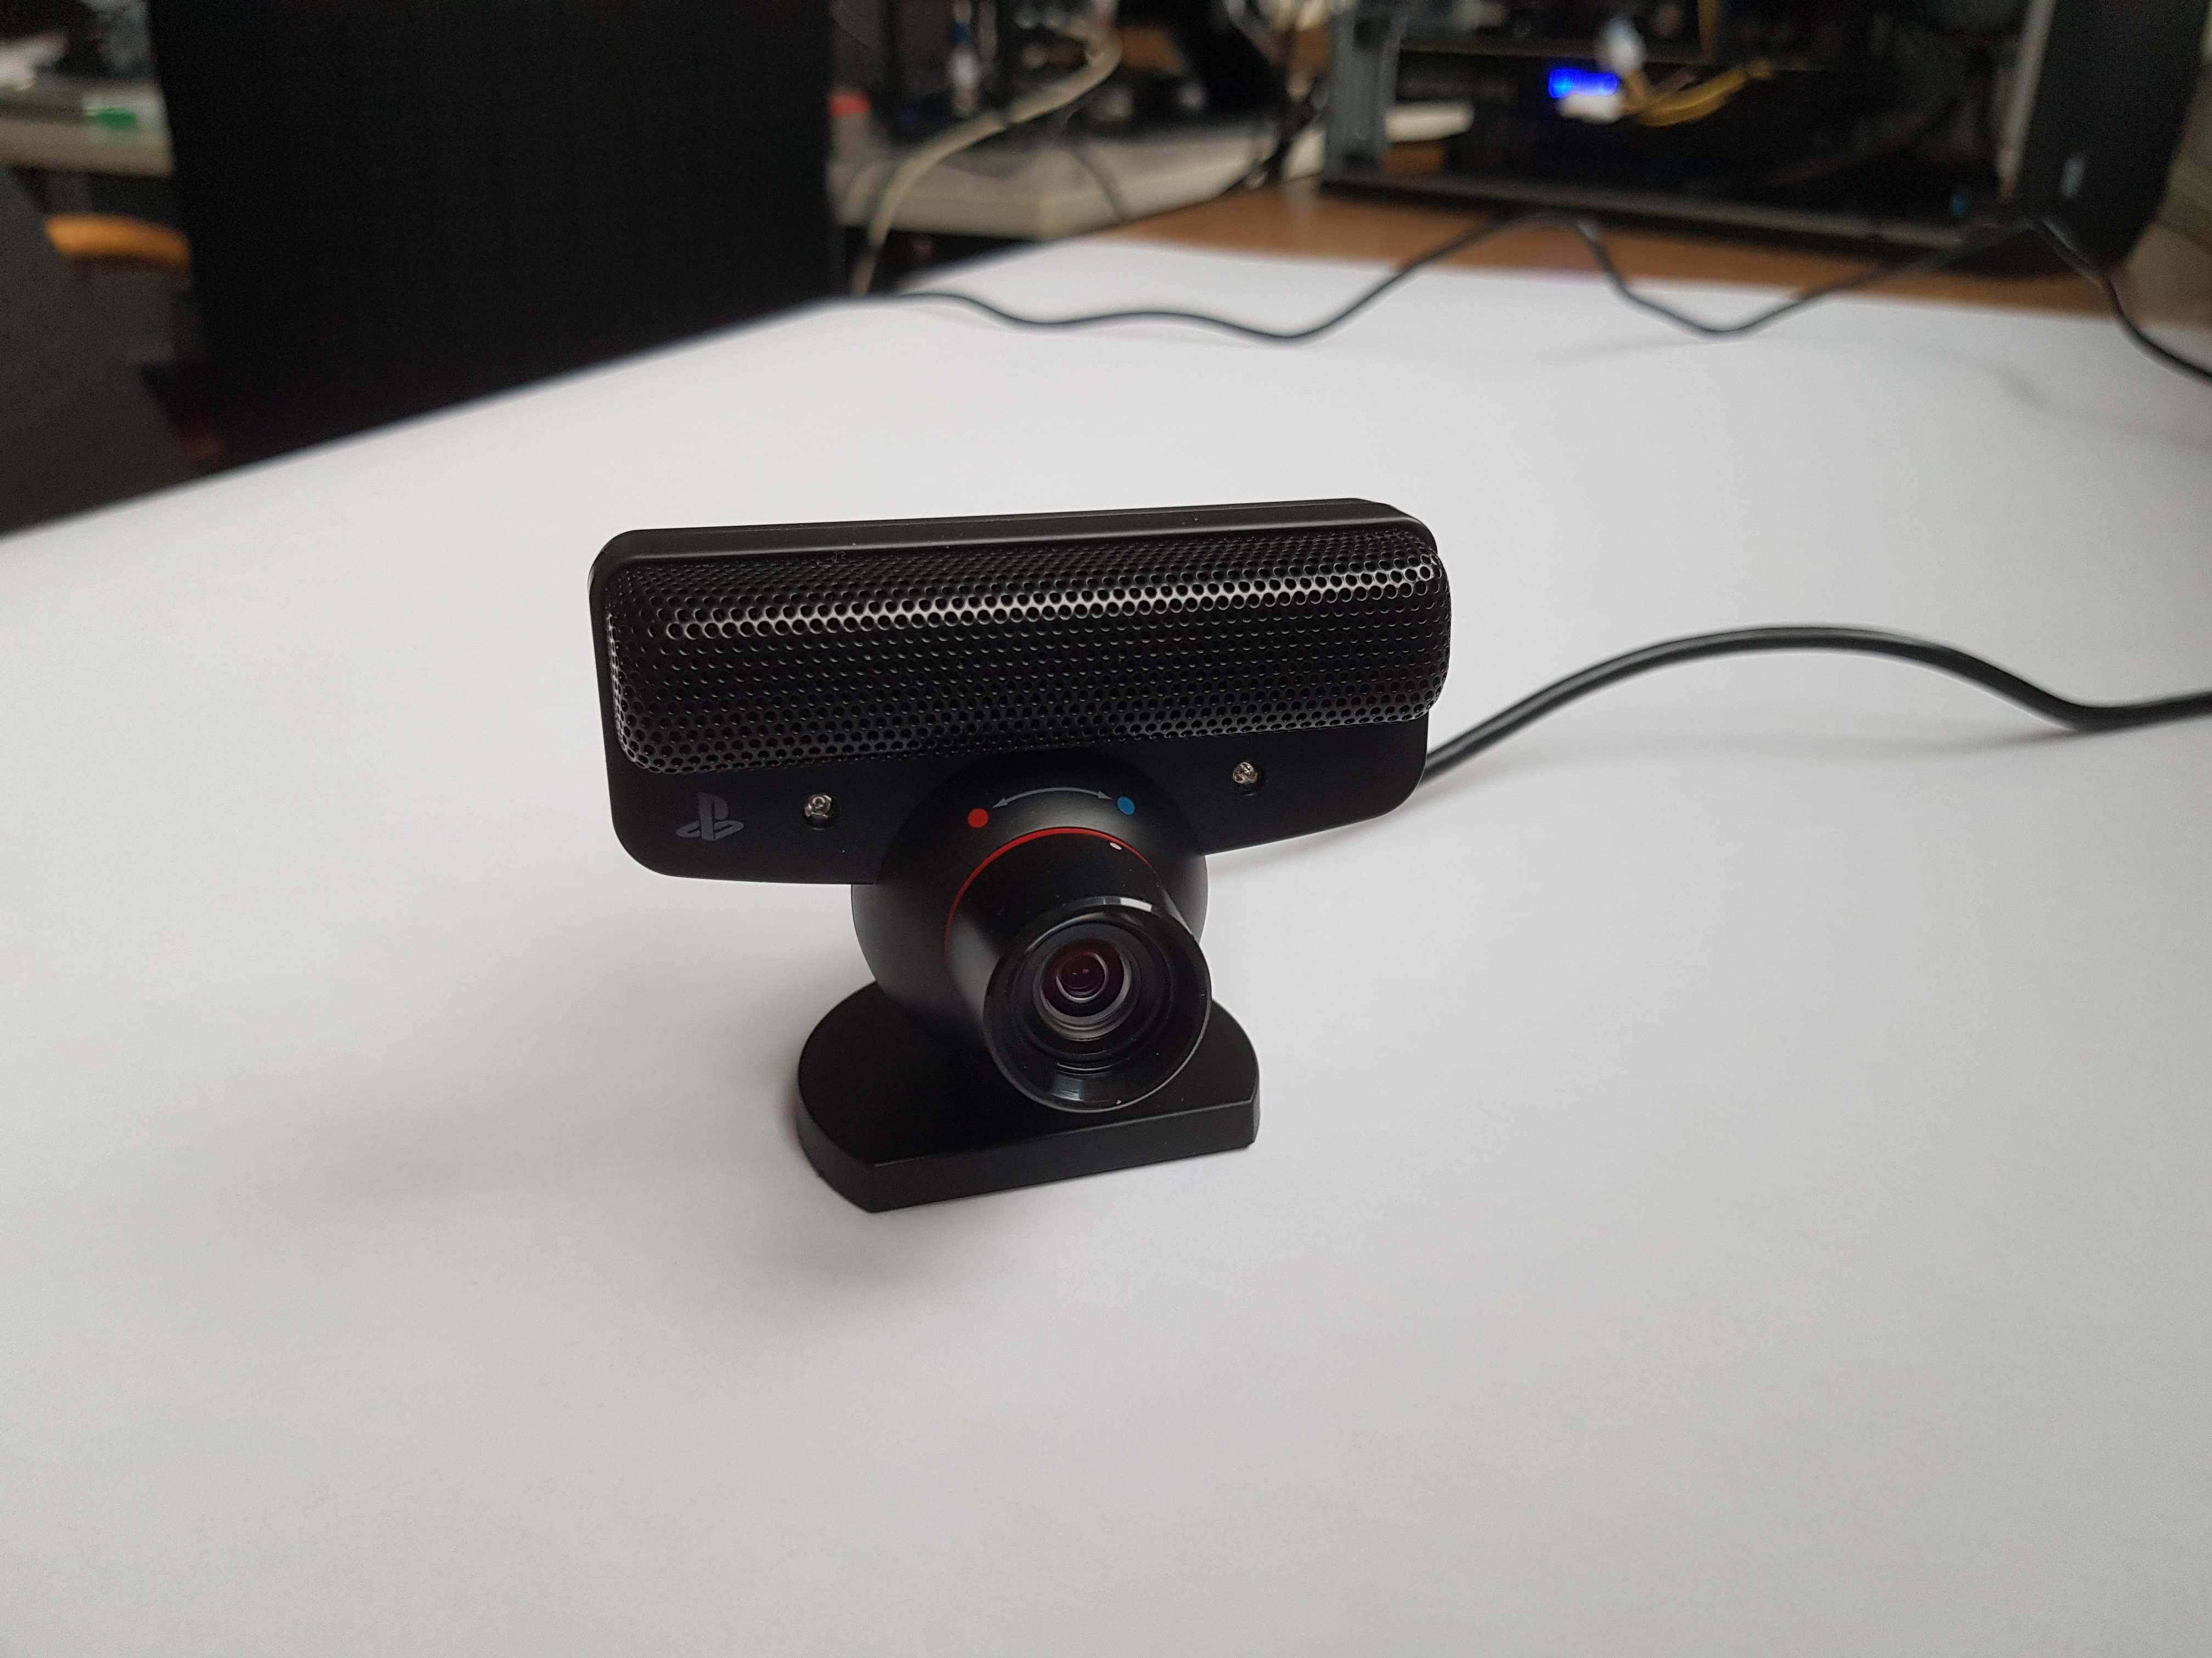
Hardware

Slide 15
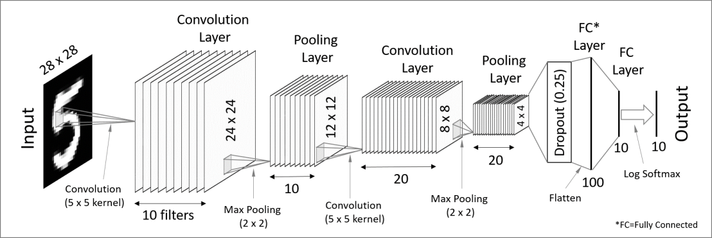
Model Implementation I
Convolutional Neural Network
Fig. 5 Convolutional Neural Network [5]

Slide 16
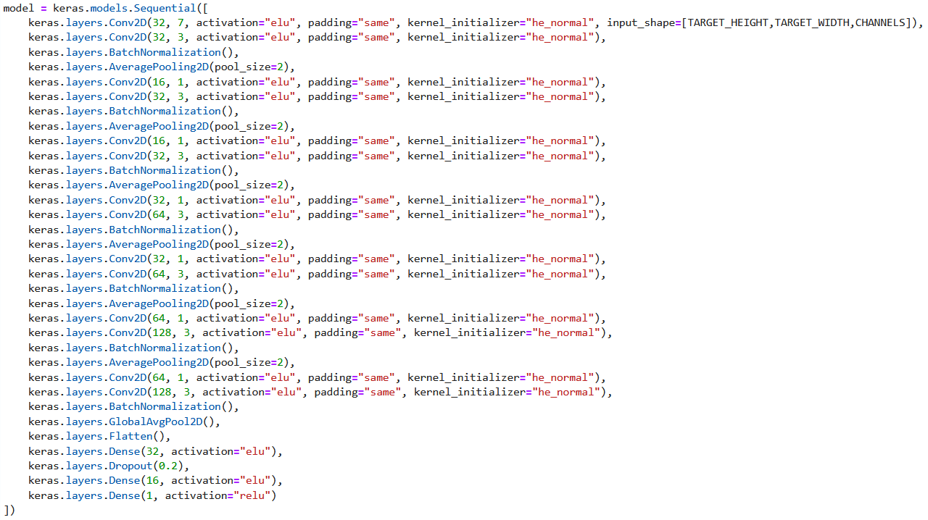
Model Implementation II

Slide 17
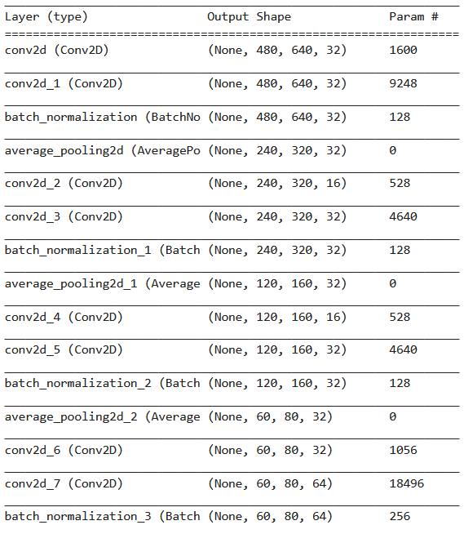
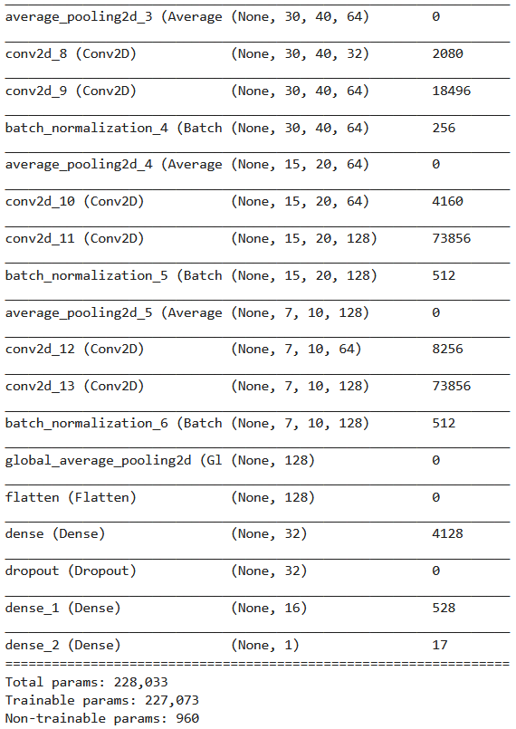
Model Implementation III

Slide 18
Bibliography
[1]: https://expertsystem.com/machine-learning-definition/
[2]: https://de.slideshare.net/liorrokach/introduction-to-machine-learning-13809045
[3]: https://www.researchgate.net/figure/A-handwriting-recognition-task-almost-successfully-solved-at-Mechanical-Turk-using-an_fig1_220269161

